Slide 1


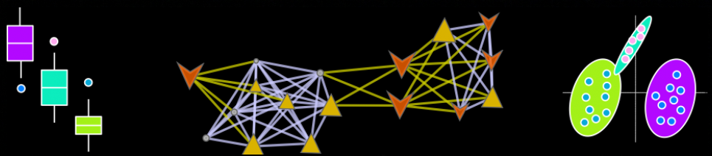
Omic Data Analysis Workflow
Dmitry Grapov, PhD
CDS- Creative Data Solutions

Slide 2
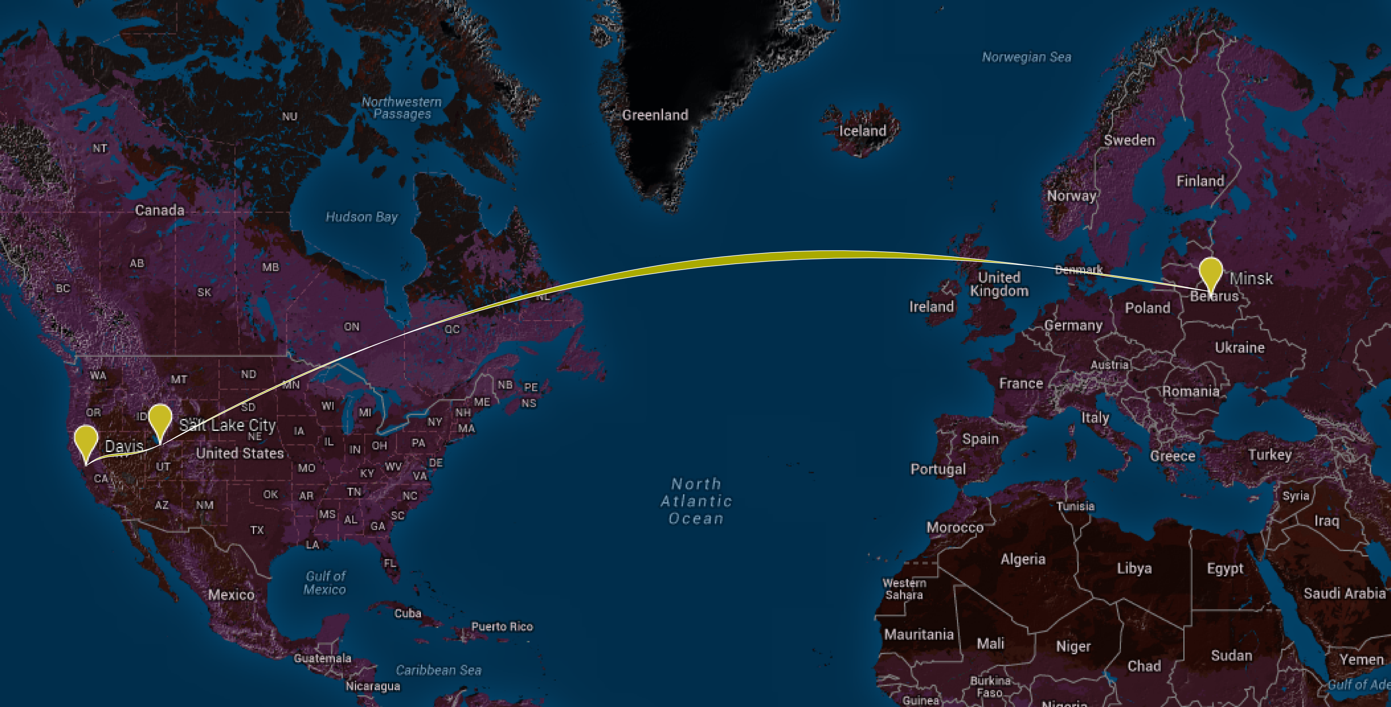






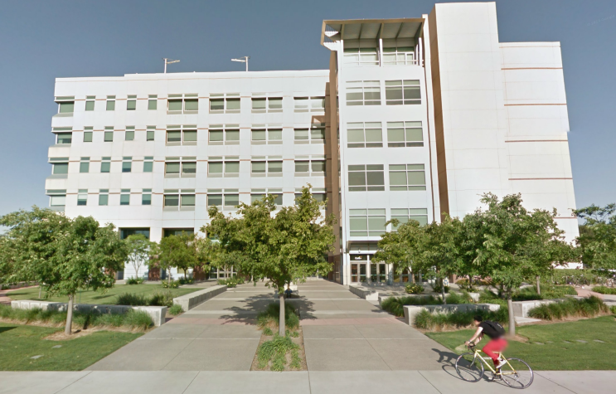
Background
Salt Lake City, UT
University of Utah (2000-2007)
B.S. Biology
B.S. Chemistry
Minsk, Belarus
St. Louis, MO
Data Scientist
CDS - Creative Data Solutions
Genome Analytics, Monsanto
Davis, CA
University of California, Davis
(2007-2012)
Ph.D. Analytical Chemistry with Emphasis in Biotechnology
Post doc, Oliver Fiehn Lab
WCMC
Born: Minsk, Belarus in 1981
Principal Statistician at the NIH West Coast Metabolomics Center (WCMC)
Interests:
Omics, integromics, microbials and big biological data
Multivariate data analysis and visualization, machine learning and software design

Slide 3
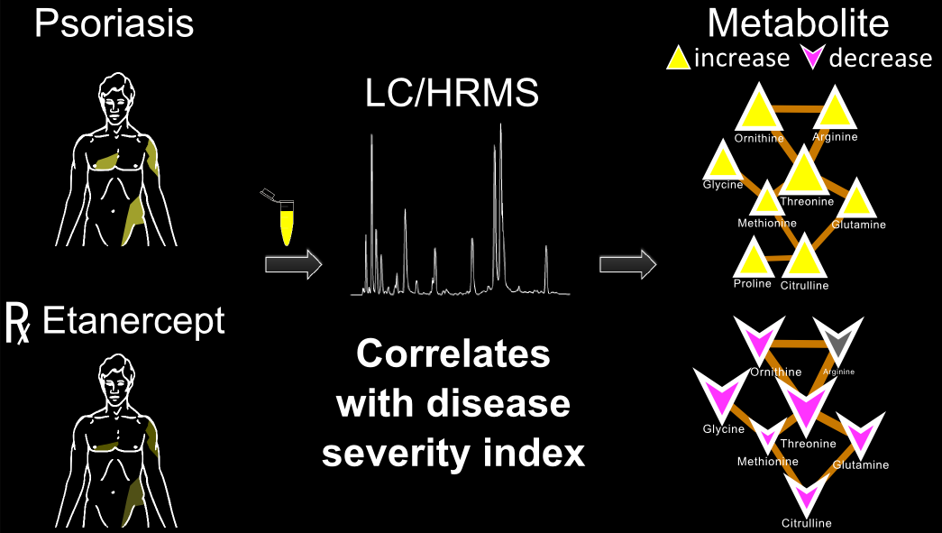
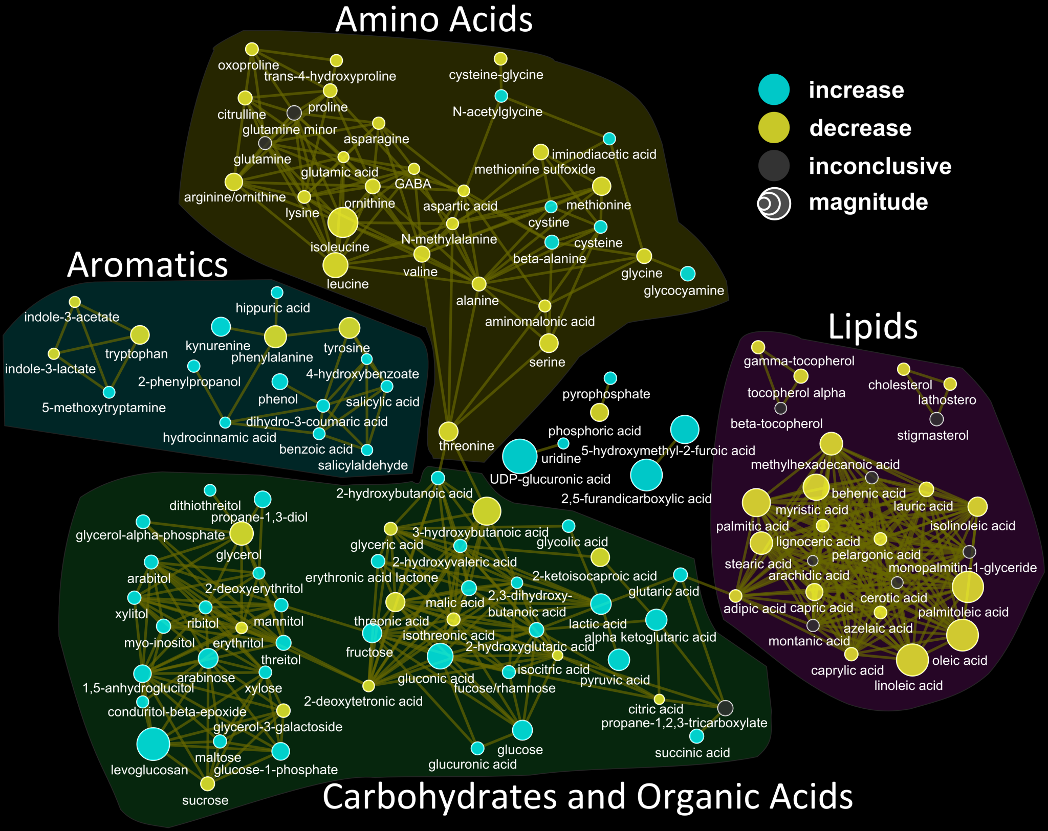
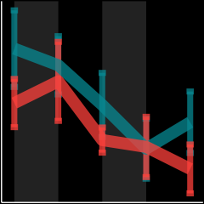
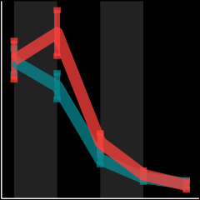
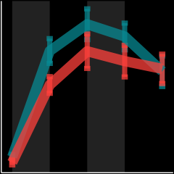

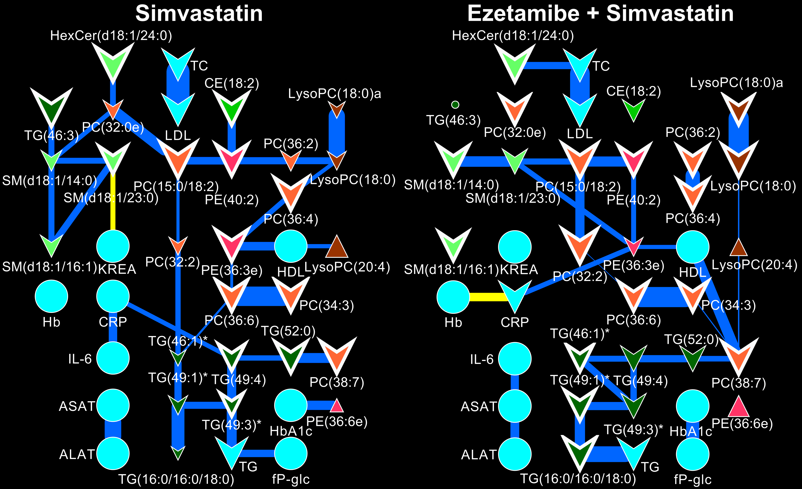
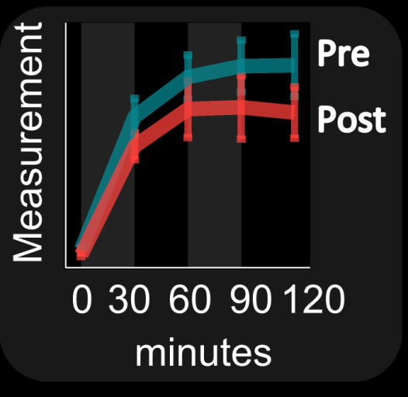
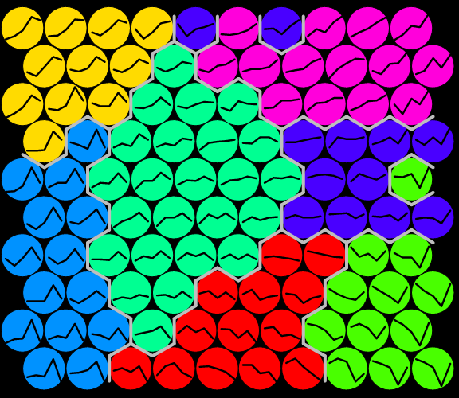
Experience: Omic’ data analysis and visualization
Biomarker validation
Multivariate Modeling
Metabolomics can offer real-time insight into treatment efficacy and drive personalized medicine decisions
J. Proteome Res., 2015, 14 (1), pp 557–566 DOI: 10.1021/pr500782g
Network Analysis
Grapov et. al., Circ. Cardiovasc. Genet. 2014
Grapov et. al.,PLoS ONE (2014) doi:10.1371/journal.pone.0084260

Slide 4
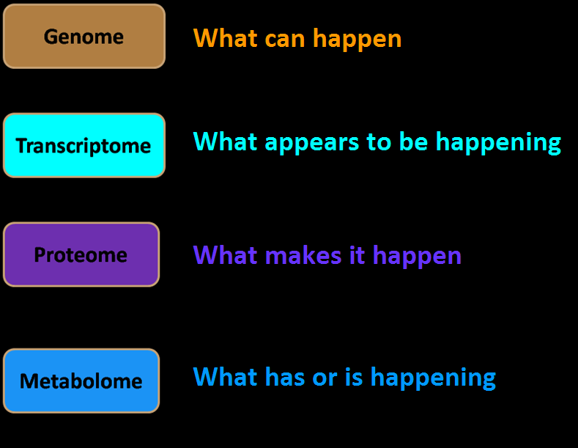
Metabolomics: study of small molecules

Slide 5
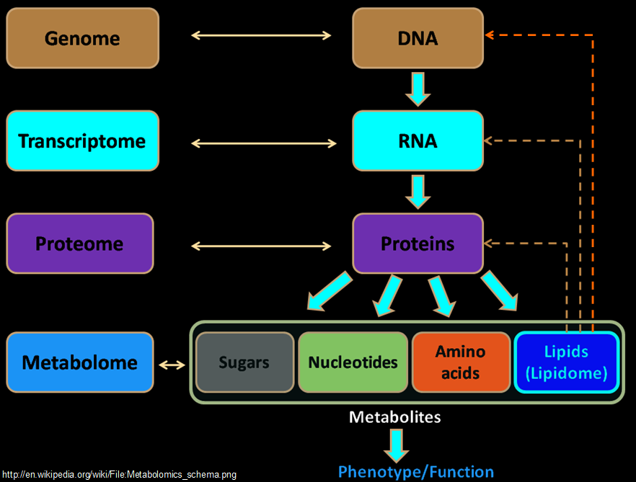
Metabolome: a proxy for phenotype

Slide 6



Need for Integromics
Type 2 Diabetes
2009
Many diseases, including aging, have dominant metabolic components (e.g. metabolic syndrome)
~10% variance explained
Genotype +
metabolome
>40% variance
explained
PMID:24204828

Slide 7
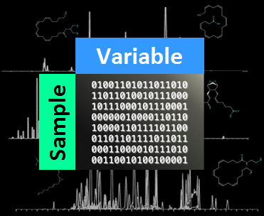
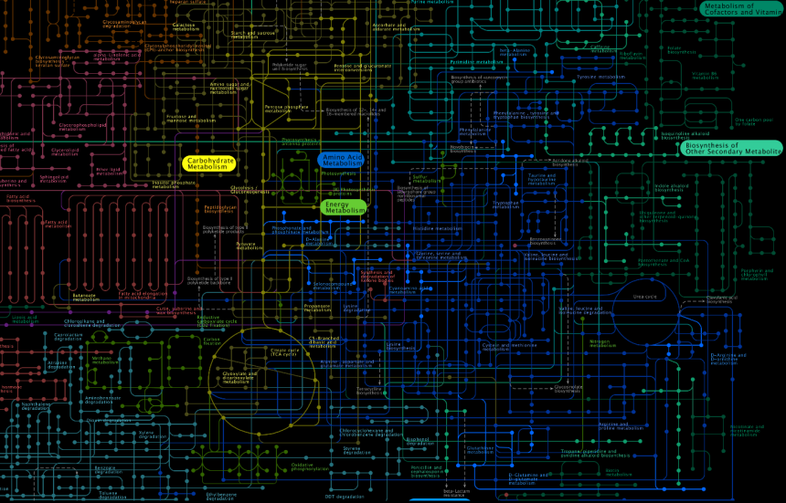
Example:
Proteomic and metabolomic data analysis
exploratory analysis
statistical analysis
predictive modeling
functional analysis
Follow along:
report/report.md
View Code:
report/report.Rmd
https://github.com/dgrapov/TeachingDemos/blob/master/Demos/Data%20Analysis%20Workflow/

Slide 8
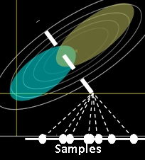

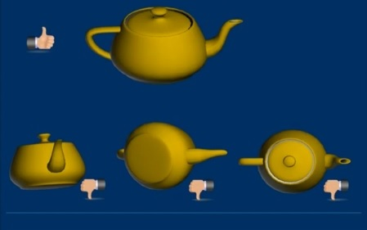
Projection of Data
The algorithm defines the position of the light source
Principal Components Analysis (PCA)
unsupervised
maximize variance (X)
Partial Least Squares Projection to Latent Structures (PLS)
supervised
maximize covariance (Y ~ X)
PC1
PC2
James X. Li, 2009, VisuMap Tech.

Slide 9
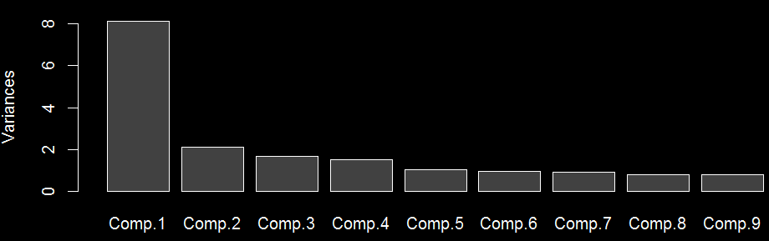
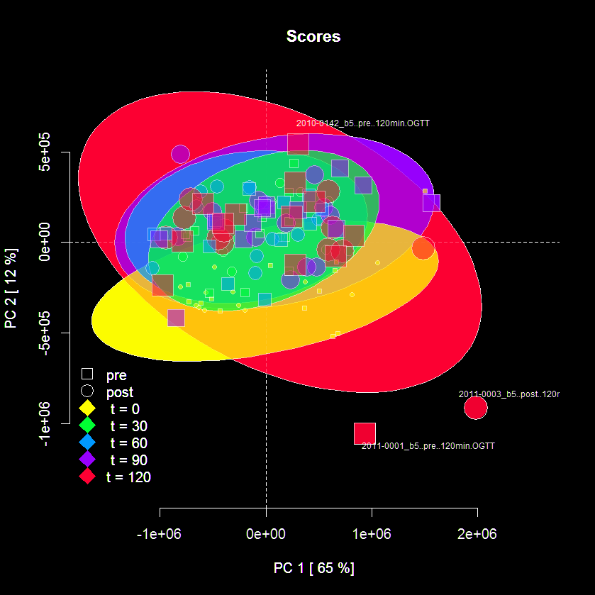
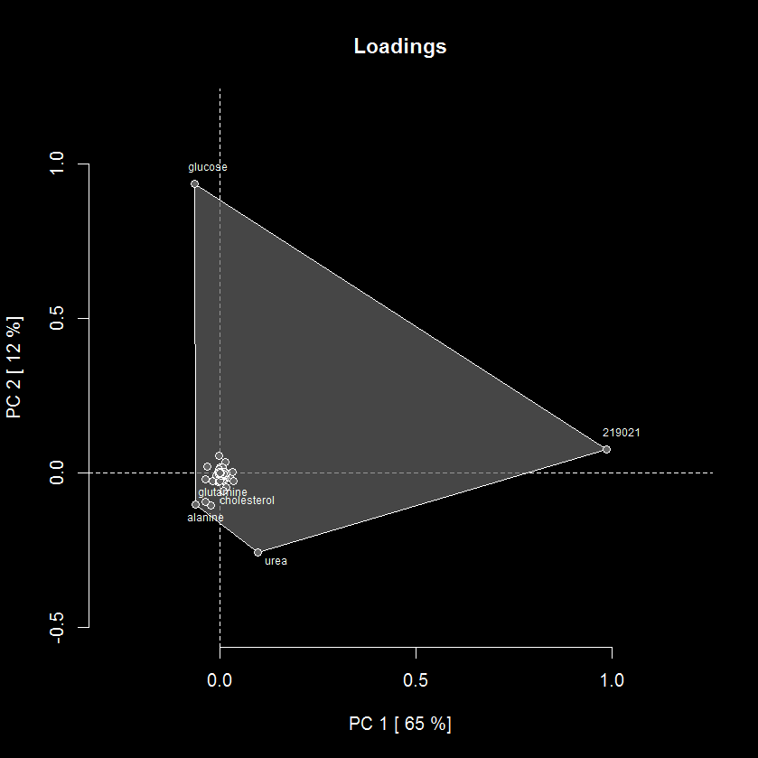
Interpreting PCA Results
Variance explained (eigenvalues) Row (sample) scores and column (variable) loadings

Slide 10
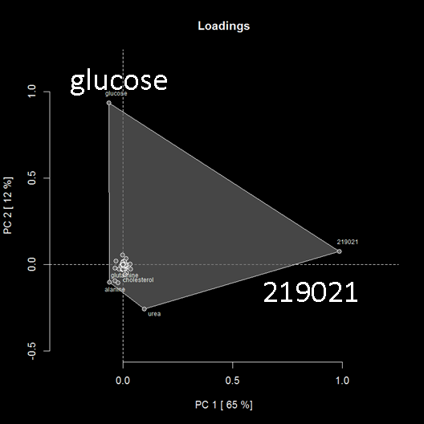
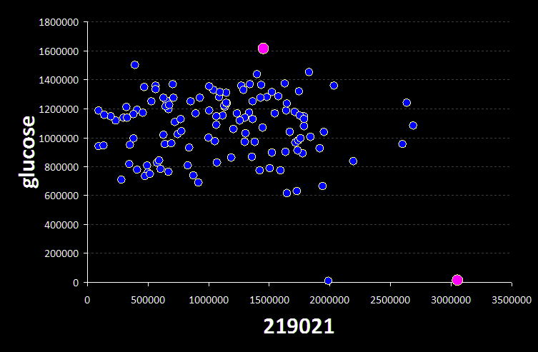
How are scores and loadings related?
Switch to:
report/report.md

Slide 11


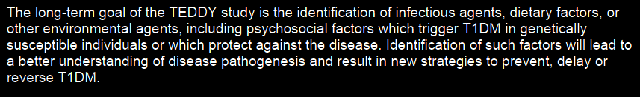
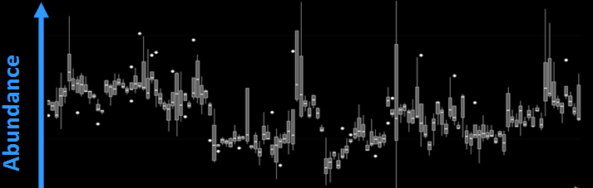
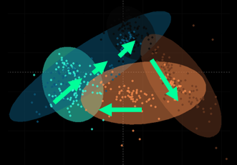
Large longitudinal studies may be required to identify small phenotypic and environmental effects
TEDDY: The Environmental Determinants of Type 1 Diabetes in the Young
multi-Omic longitudinal study involving > 15,000 samples acquired over 3 yrs
Analytical batch effects can hide smaller biological effects
Time
Time
http://teddy.epi.usf.edu/TEDDY/

Slide 12
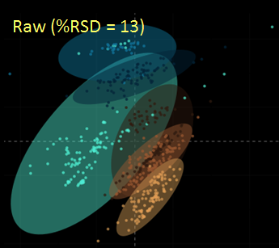
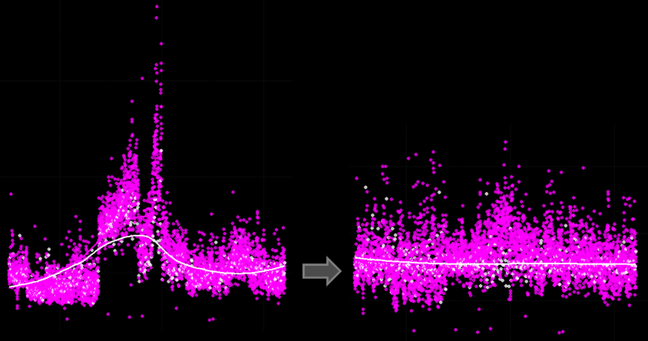
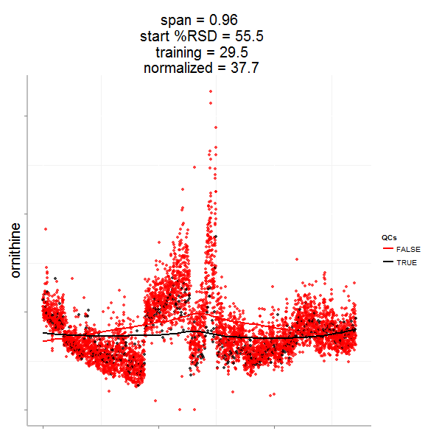
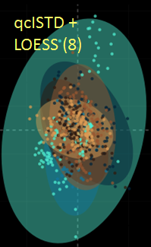
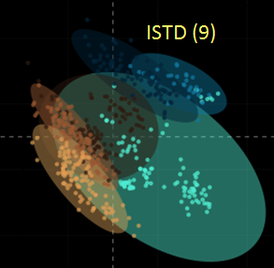
Data normalization may require a combination of approaches
Internal standard (ISTD) based normalization may not fully remove analytical batch effects
Analytical replicate-based normalizations can be used to estimate and remove analytical variance
Raw Data
Normalized Data
Samples
QCs
LOESS

Slide 13

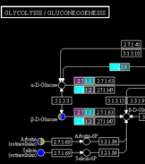
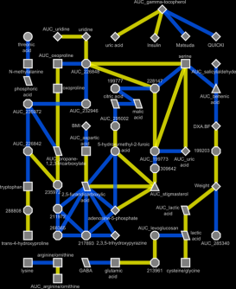
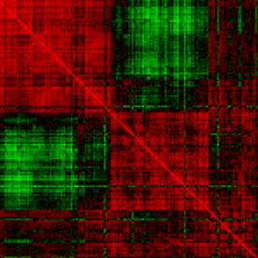
Omic’ data integration strategies
Biochemical pathway
Network based
Empirical correlation
Biomarker Insights 2015:Suppl. 4 1-6 DOI: 10.4137/BMI.S29511

Slide 14
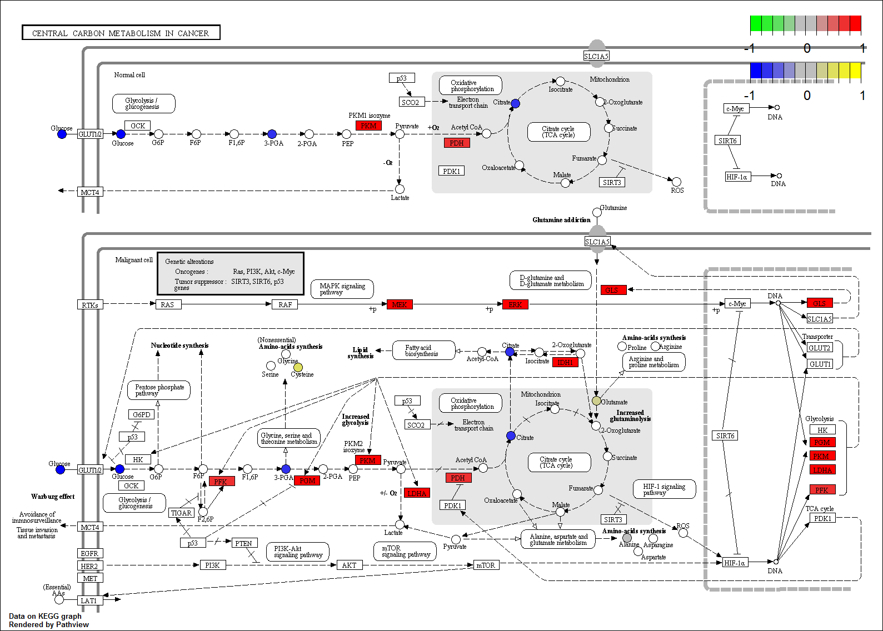
Pathway analysis

Slide 15


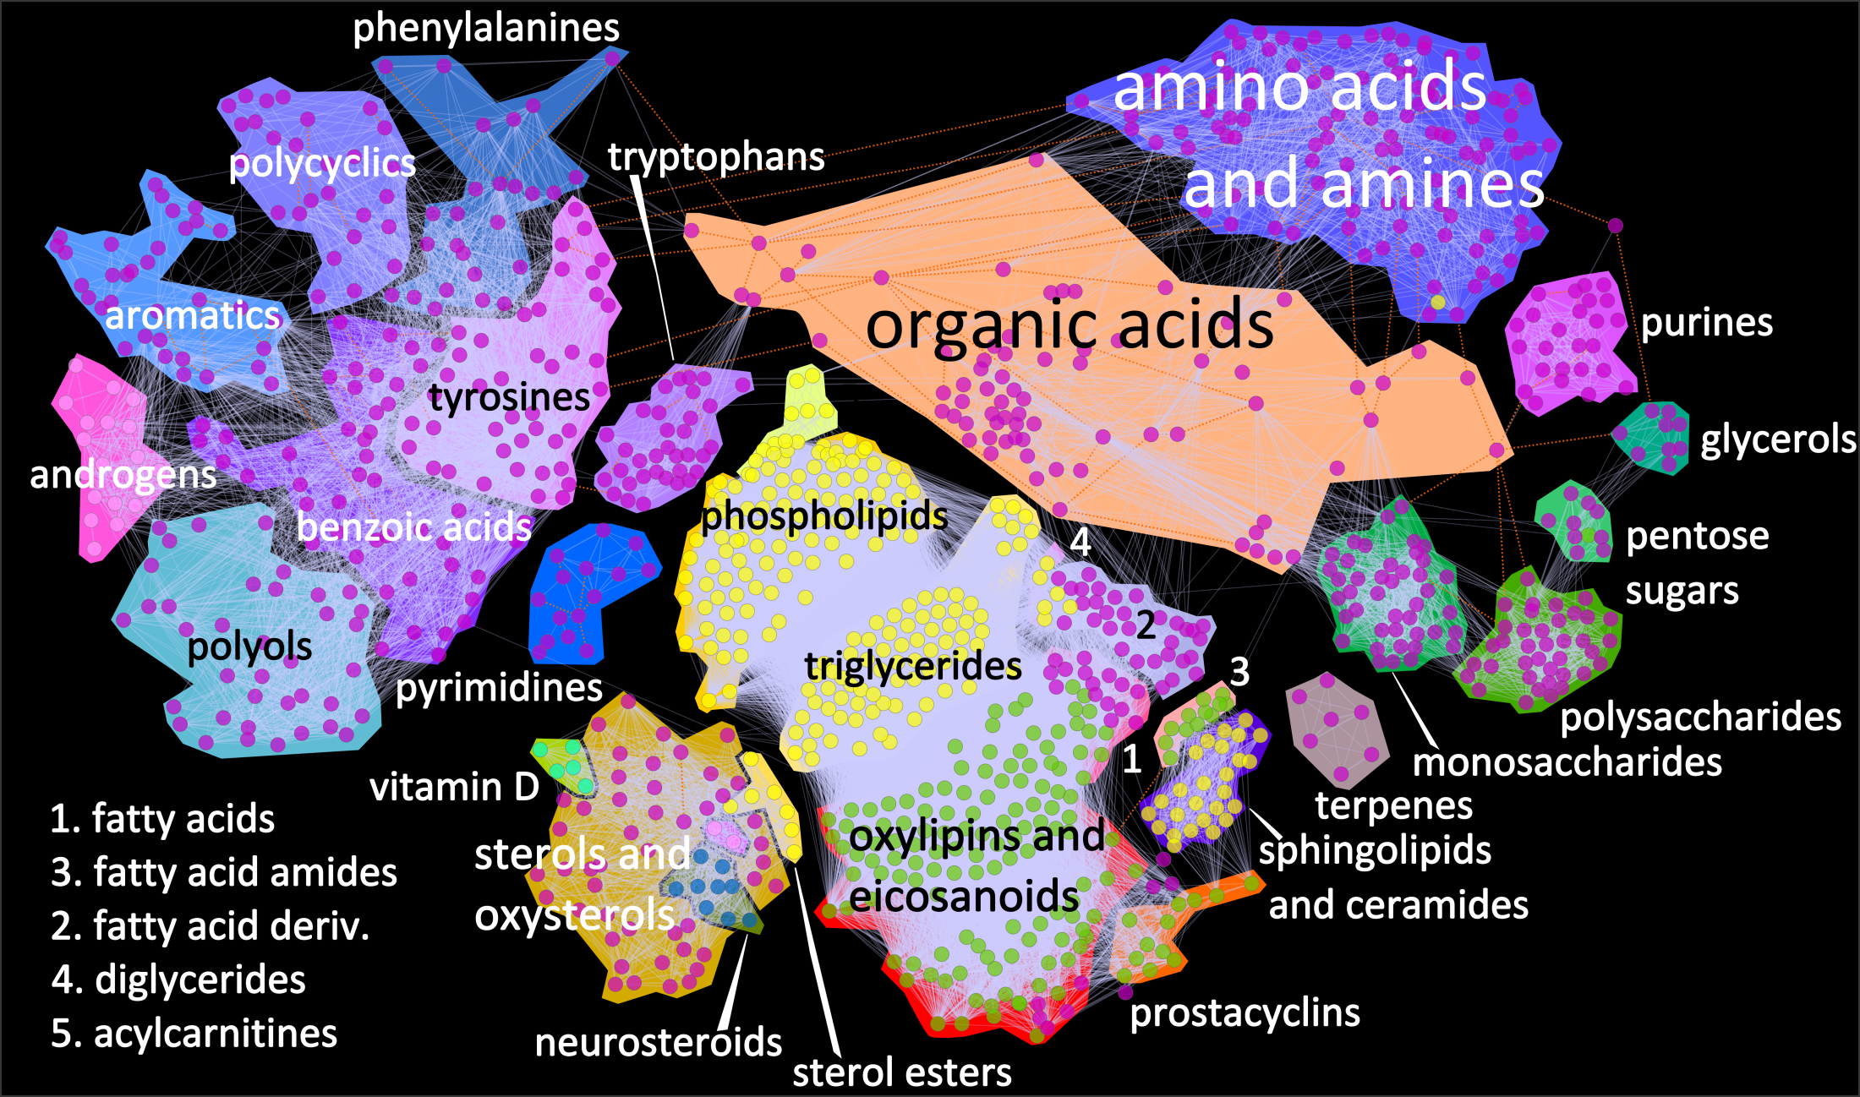
Metabolomic network analysis

Slide 16
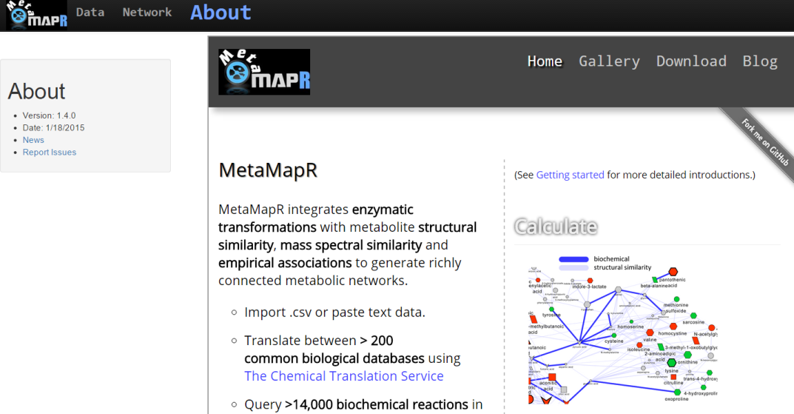



MetaMapR: Metabolomic network calculation
http://dgrapov.github.io/MetaMapR/

Slide 17
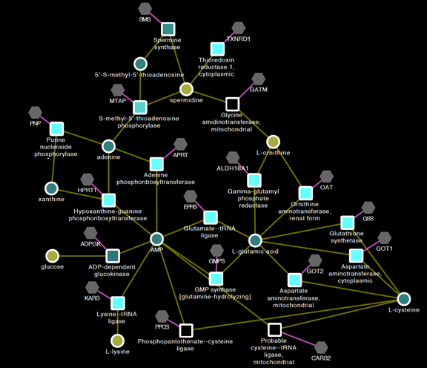
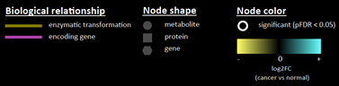

Omic’ network analysis
http://kwanjeeraw.github.io/grinn/

Slide 18
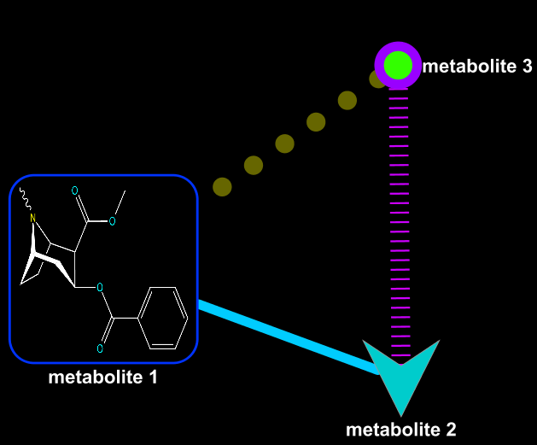
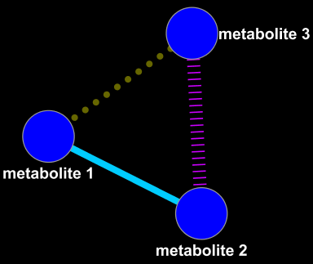
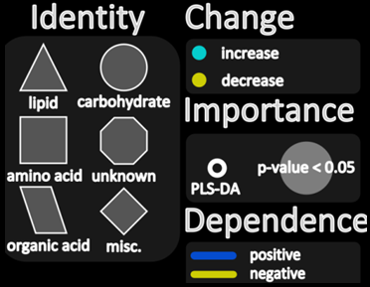



Network Mapping
+
=
Network
Mappings
Mapped Network
Grapov D.,American Society of Mass Spectrometry Conference (2013, 2014)

Slide 19
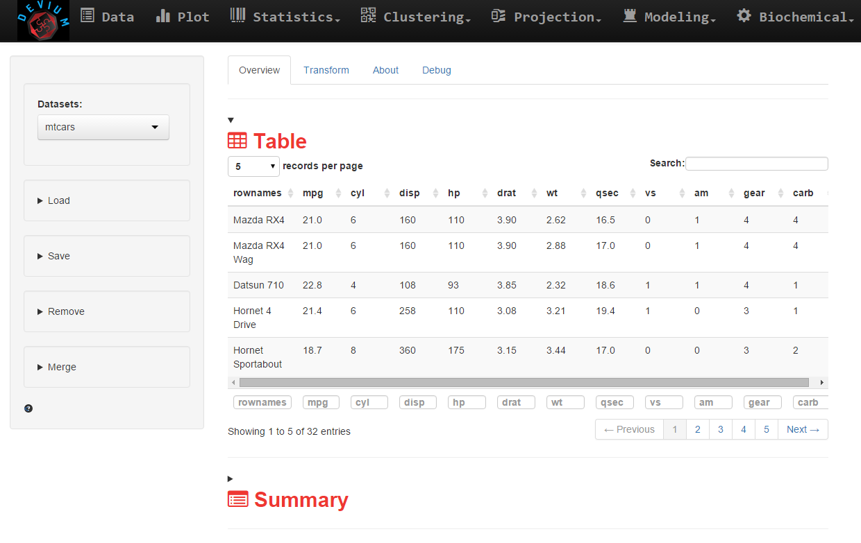
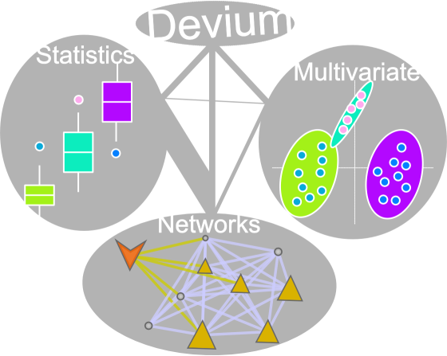
DeviumWeb: Data analysis and visualization
https://github.com/dgrapov/DeviumWeb

Slide 20
Questions?
dgrapov@gmail.com
More information:
https://imdevsoftware.wordpress.com/
Software:
https://github.com/dgrapov
Hire me:
createdatasol@gmail.com

